Slide 1
Exploring Drawing: Looking at current practicing Native Artists from the Midwest
Notes:
Contour (blind and semi-blind)
Gesture (brief and long)
Sighting and organizational line
Compositional considerations
Negative shapes
Line variation
Volumetric solids
Cross-contour
Planar structure
Value
Linear perspective: One-Point perspective
Two-point perspective
Movement and gesture

Slide 2
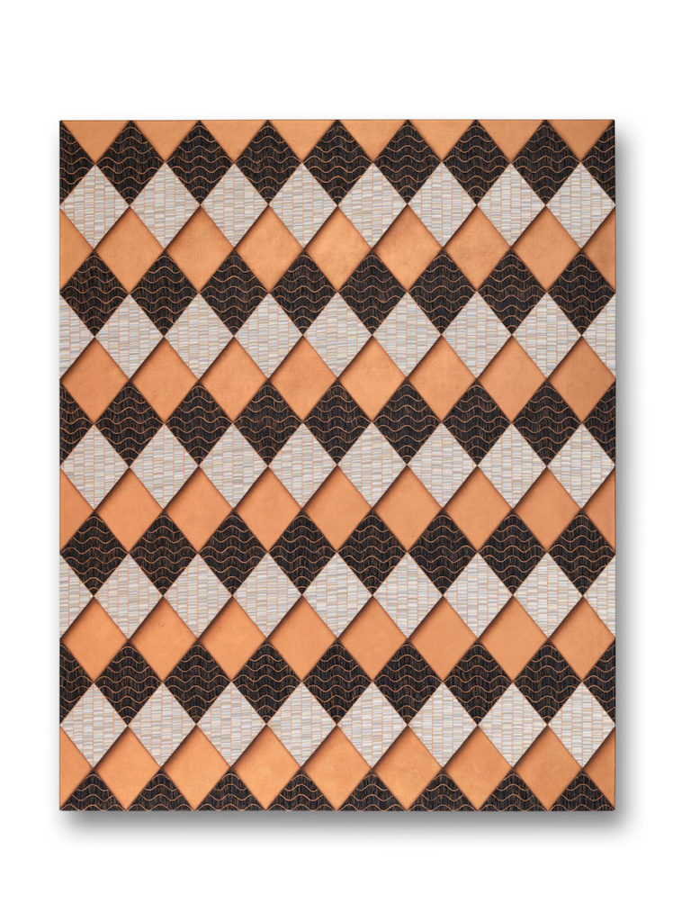
Dyani White Hawk
She Gives (Quiet Strength V), 2019
Acriylic on canvas, 60 x 48in.
https://www.dyaniwhitehawk.com/painting/#jp-carousel-796
Notes:
Dyani White Hawk
She Gives (Quiet Strength V), 2019
Acriylic on canvas, 60 x 48in.
https://www.dyaniwhitehawk.com/painting/#jp-carousel-796
Dyani White Hawk (Sičáŋǧu Lakota) is a visual artist and independent curator based in Minneapolis, Minnesota.

Slide 3
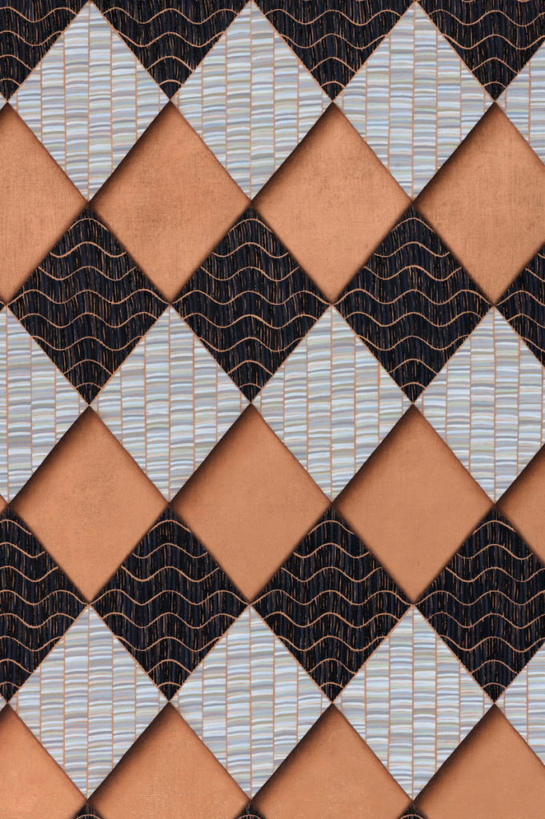
Dyani White Hawk
She Gives (Quiet Strength V), 2019 DETAIL
Acriylic on canvas, 60 x 48in.
https://www.dyaniwhitehawk.com/painting/#jp-carousel-797
Notes:
Dyani White Hawk
She Gives (Quiet Strength V), 2019 DETAIL
Acriylic on canvas, 60 x 48in.
https://www.dyaniwhitehawk.com/painting/#jp-carousel-797
Line/brushstroke
Texture

Slide 4
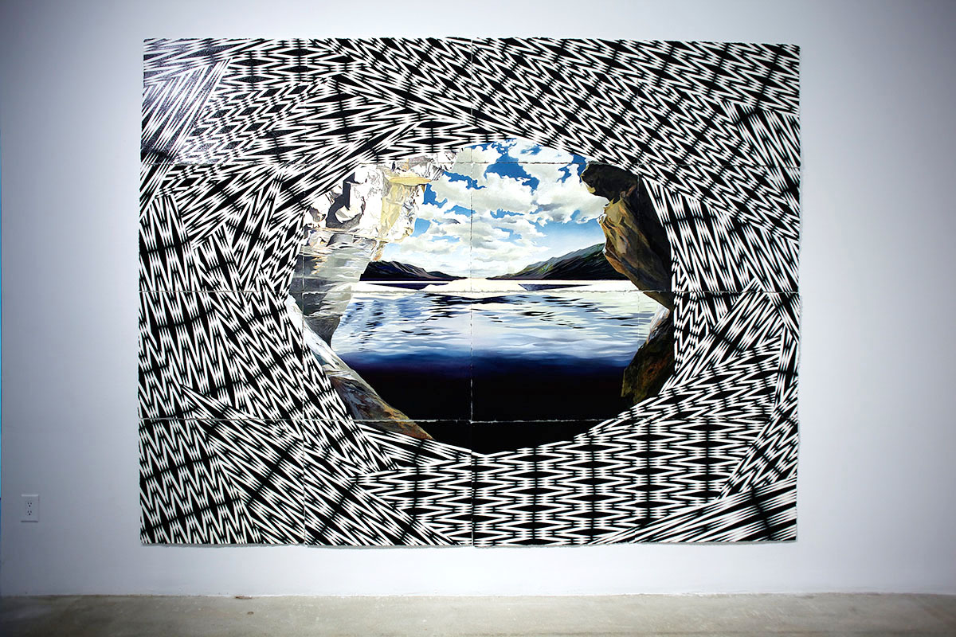
Andrea Carlson
The Tempest, 2008
Ink, oil, acrylic, crayon, gouache, coloured pencil and graphite on paper
243.8 x 304.8 cm
http://www.magentafoundation.org/magazine/andrea-carlson/
Notes:
Andrea Carlson
The Tempest, 2008
Ink, oil, acrylic, crayon, gouache, coloured pencil and graphite on paper, 243.8 x 304.8 cm
http://www.magentafoundation.org/magazine/andrea-carlson/
Perspective
line

Slide 5
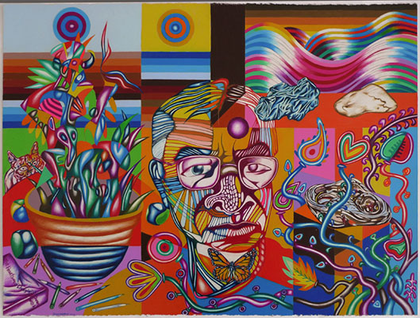
Frank Big Bear
Self Portrait in Studio with Bowtie, 2014
22 x 30.25in.
Color pencil on paper
http://www.bockleygallery.com/artist_big_bear/exhibition_3/06.html
Notes:
Frank Big Bear
Self Portrait in Studio with Bowtie, 2014
22 x 30.25in.
Color pencil on paper
http://www.bockleygallery.com/artist_big_bear/exhibition_3/06.html
Ojibwe, White Earth
Born: 1953
Grew up around White Earth, spent many years in Minneapolis
Perspective
Line
Shading
texture
Volumetric solids
Negative shapes

Slide 6
Star Wallowing Bull
Black Elk’s Little Sandman, 2002
Prisma color pencil on paper, 36 x 50in.
https://plainsart.org/wp-content/uploads/2016/12/Star-Wallowing-Bull.jpg
Notes:
Star Wallowing Bull
Black Elk’s Little Sandman, 2002
Prisma color pencil on paper, 36 x 50in.
https://plainsart.org/wp-content/uploads/2016/12/Star-Wallowing-Bull.jpg
Ojibwe-Arapaho, White Earth
Born: 1973
Born/raised: Minneapolis
Lives in: Fargo/Moorhead area
Perspective
Line
Volumetric solids
Negative shapes

Slide 7
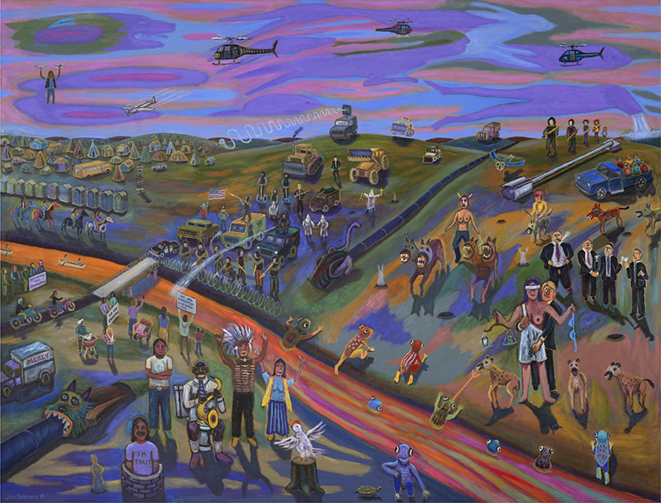
Jim Denomie
Standing Rock 2016, 2018
92 x 120in.
Oil on canvas
http://www.bockleygallery.com/artist_denomie/exhibition_4/01.html
Notes:
Jim Denomie
Standing Rock 2016, 2018
92 x 120in.
Oil on canvas
http://www.bockleygallery.com/artist_denomie/exhibition_4/01.html
Ojibwe
perspective
Born: 1955
Perspective
Texture

Slide 8
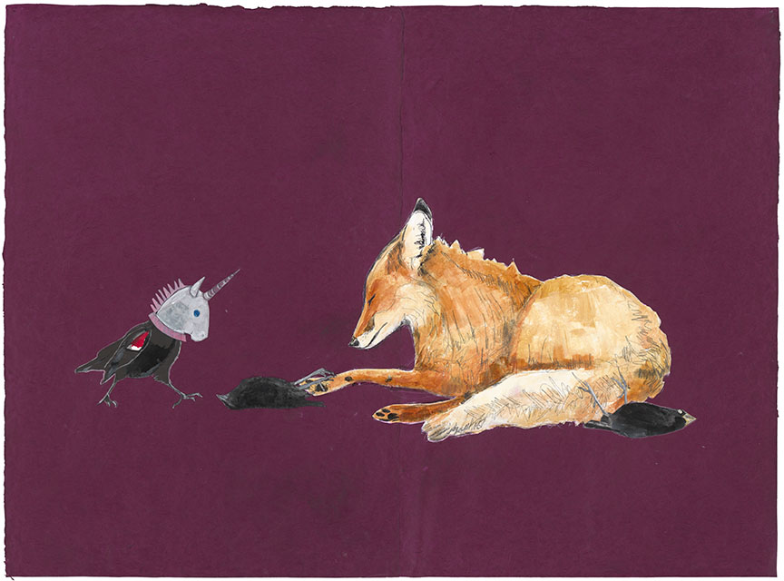
Julie Buffalohead
Untitled, 2017
Acrylic, ink and pencil on Lokta paper
28.5 x 30.25 inches
http://bockleygallery.com/artist_buffalohead/available/05_large.html
Notes:
Julie Buffalohead
Untitled, 2017
Acrylic, ink and pencil on Lokta paper
28.5 x 30.25 inches
http://bockleygallery.com/artist_buffalohead/available/05_large.html
Julie Buffalohead, born in 1972 is an enrolled member of the Ponca Tribe of Oklahoma
Perspective
Line
Shading
Texture
Contour
Volumetric solids
Negative shapes

